Slide 1
2022 MIT Momentum
Visualization Overview
Dec 21st 2021
Irina Lavryonova

Slide 2

Agenda
Purpose and Scope
Major Features
How to Launch
Map Usage

Slide 3
Purpose and Scope
Project Scope
Create geo-referenced 2D maps of land and water
Visualize the movement of student drones relative to this map environment
Visualize the locations of survivors, fire, and water depending on the type of mission, and have those objects react to the drone’s actions
Perform scoring
Ensure that the visualization is light enough to run on an average laptop
Potential Expansions
Implement optional effects of wind on survivors and fire
Give students hooks into the survivor/fire/water live status data for online planning
The materials and screenshots presented in this presentation are accurate as of 14 DEC 2021. This software may evolve and the screenshots may no longer be perfect representations of the interfaces or functionality

Slide 4
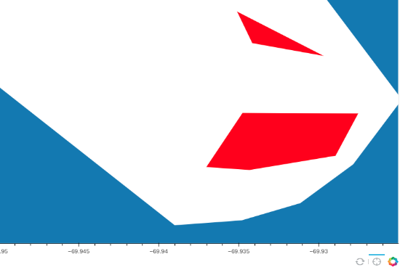
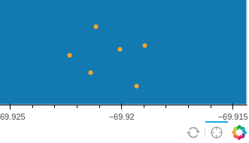
Major Features
Modes:
MapMaker – allows the user to create maps from scratch using the provided tools for either or both tracks
MapEditor – allows the user to edit existing maps or create derivative ones
Visualizer – allows the user to visualize the positions of the drone and objects of interest (fire, water, survivors), and see relevant mission statistics
Map types:
Search & Rescue – maps have hidden survivors that are shown when the drone is close enough to “see” the survivor
Fire Suppression – maps have areas of fire and water, which the drone can interact with via position in order to pick up water and extinguish fires
Written in Python, runs in the browser
Interfaces with student code in the background with a 100 Hz update rate
Fire & Water
Survivors

Slide 5
How to Launch
The visualization source code is hosted on GitHub (you need to request access)
Follow the instructions on the project readme to pull or update the repository
You may need to set up your SSH keys if this is your first time pulling from a private repository
Make Google Chrome your default browser
Navigate to the root of the project and use the following to launch the visualization in the specified mode
MapMaker: bokeh serve Visualizer --show --args –m
MapEditor: bokeh serve Visualizer --show --args -m <mapname>
Visualizer: bokeh serve Visualizer --show --args -v <mapname>
The visualization will open in your default browser at http://localhost:5006/Visualizer in the mode you request

Slide 6
Usage: Overview
MapMaker/MapEditor
Pan and zoom
Bind and reset map
Place and delete survivors
Place and delete fires
Bulk delete fires or survivors
Select map type
Save map
Edit map
Create derivative map
Visualizer
Miscellaneous features

Slide 7

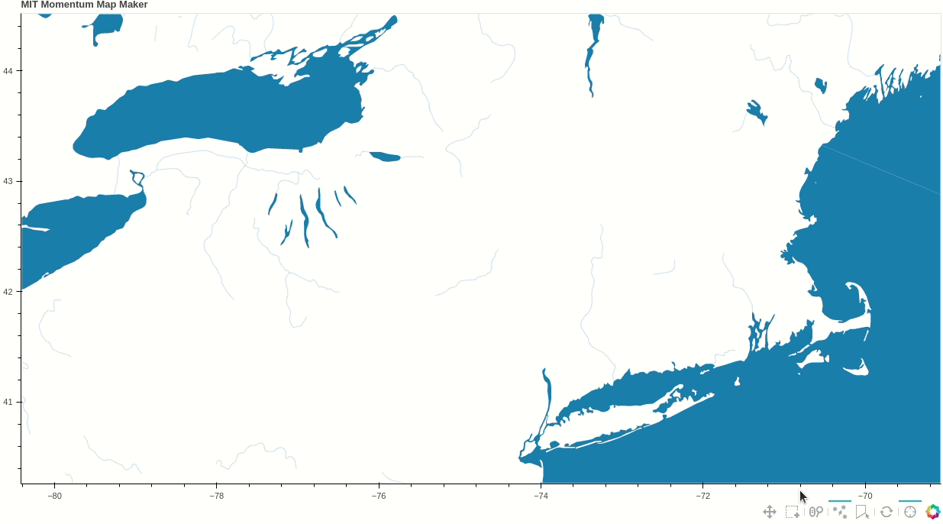

Usage: Pan, Zoom, Bind
Pan
Select the pan tool from the toolbar
Click and drag with left-mouse wheel to drag the map around
Zoom
Select the wheel-zoom tool from the toolbar
Rotate mouse-wheel to zoom in and out
You can pan and zoom at the same time (you have to have both tools selected)

Slide 8

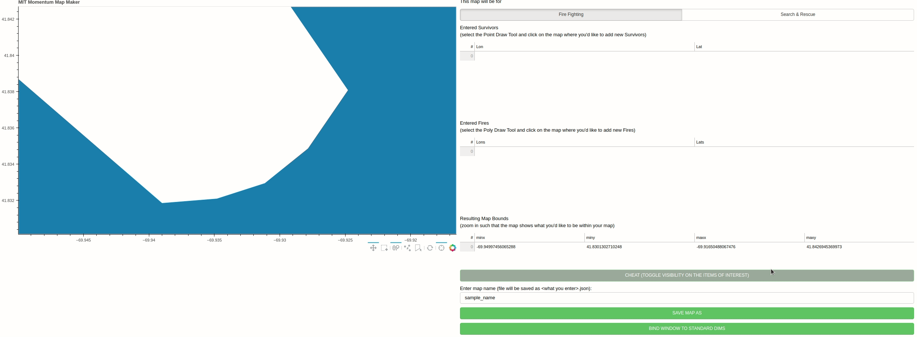
Usage: Bind and Reset Map
Bind
Once you have the area you want to use approximately in your view, click BIND WINDOW TO STANDARD DIMS to create a map of standard size
This operation is performed about the center of the view
Reset
Click the reset tool to reset the map view to where the MapMaker starts

Slide 9
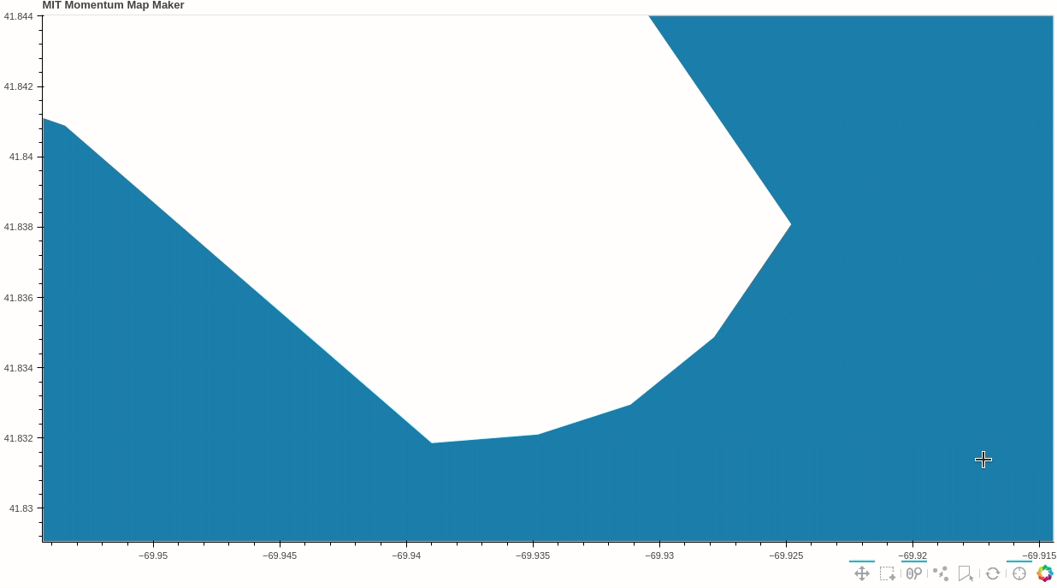

Usage: Place and Delete Survivors
Add survivors
Select the survivor tool from the toolbar
Left-mouse click on the map where you want to place survivors
If you are clicking quickly and only some of your survivors are showing, go slower and only add another survivor when the previous one has already appeared
Delete survivors
Select the survivor tool from the toolbar
Click on the survivor you want to delete on the map
With the cursor on the map, press backspace on your keyboard

Slide 10


Usage: Place and Delete Fires
Add fires
Select the fire tool from the toolbar
Double left-mouse click where on the map you want to start placing a fire
Left-mouse click where on the map you want to place additional vertices of the fire
Double left-mouse click where on the map you want to have the last fire vertex
If you are clicking quickly and only some of the vertices are showing or none are appearing, try clicking slowly and allowing each action to register before submitting another one
Delete fires
Select the fire tool from the toolbar
Click on the fire you want to delete on the map
With the cursor on the map, press backspace on your keyboard

Slide 11
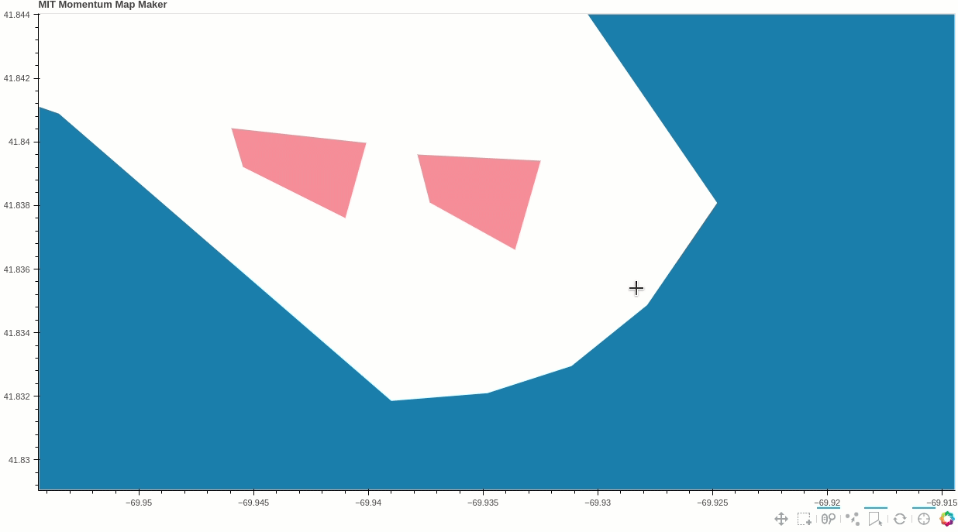

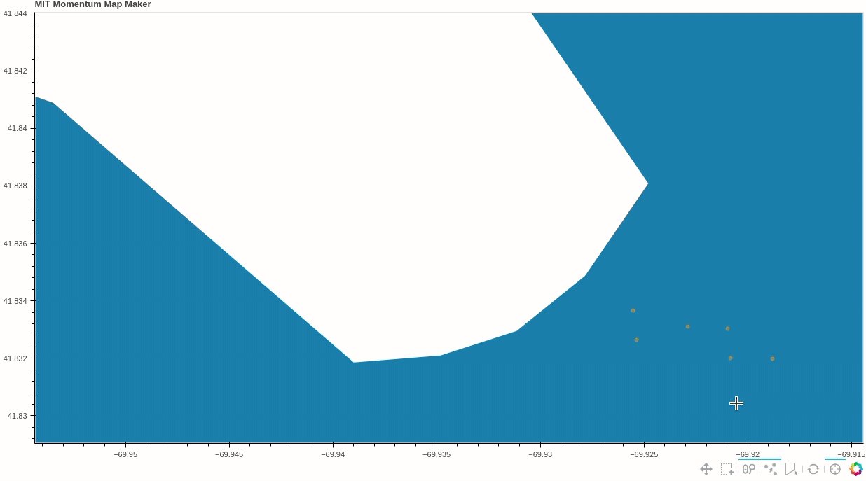
Usage: Bulk Delete Fires or Survivors
This action is the same for both types of objects of interest
You can delete one type of object of interest at a time
Select the box select tool from the toolbar
Left-mouse click and drag the box, fully enveloping the objects you want to delete
Release the left-mouse button
The object you selected should go bold and the unselected dull
Select the tool that creates the objects that you want to delete
( or )
With the cursor on the map, press backspace on your keyboard

Slide 12
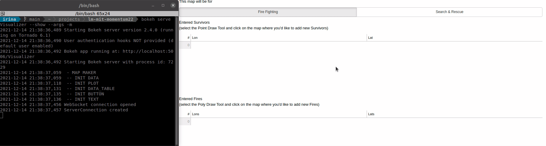
Usage: Select Map Type
Use the radio buttons to indicate which map type you are creating

Slide 13
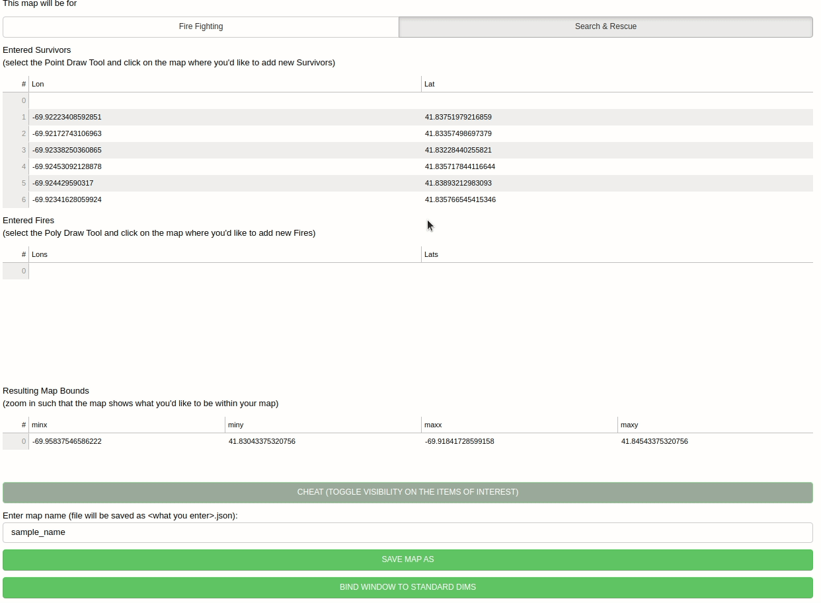
Usage: Save Map
Enter the name of the map you created
Click SAVE AS
The map will be saved to lm-mit-momentum22/maps/<your_map_name>.json

Slide 14

Usage: Edit Map
Launch the MapEditor using instructions on slide 5 and specify the map you want to edit (without .json)
Make your edits
Keep the prepopulated name
Click SAVE AS

Slide 15

Usage: Create Derivative Map
Launch the MapEditor using instructions on slide 5 and specify the map you want to use as your base (without .json)
Make your edits
Enter a new and unique name for your map
Click SAVE AS

Slide 16

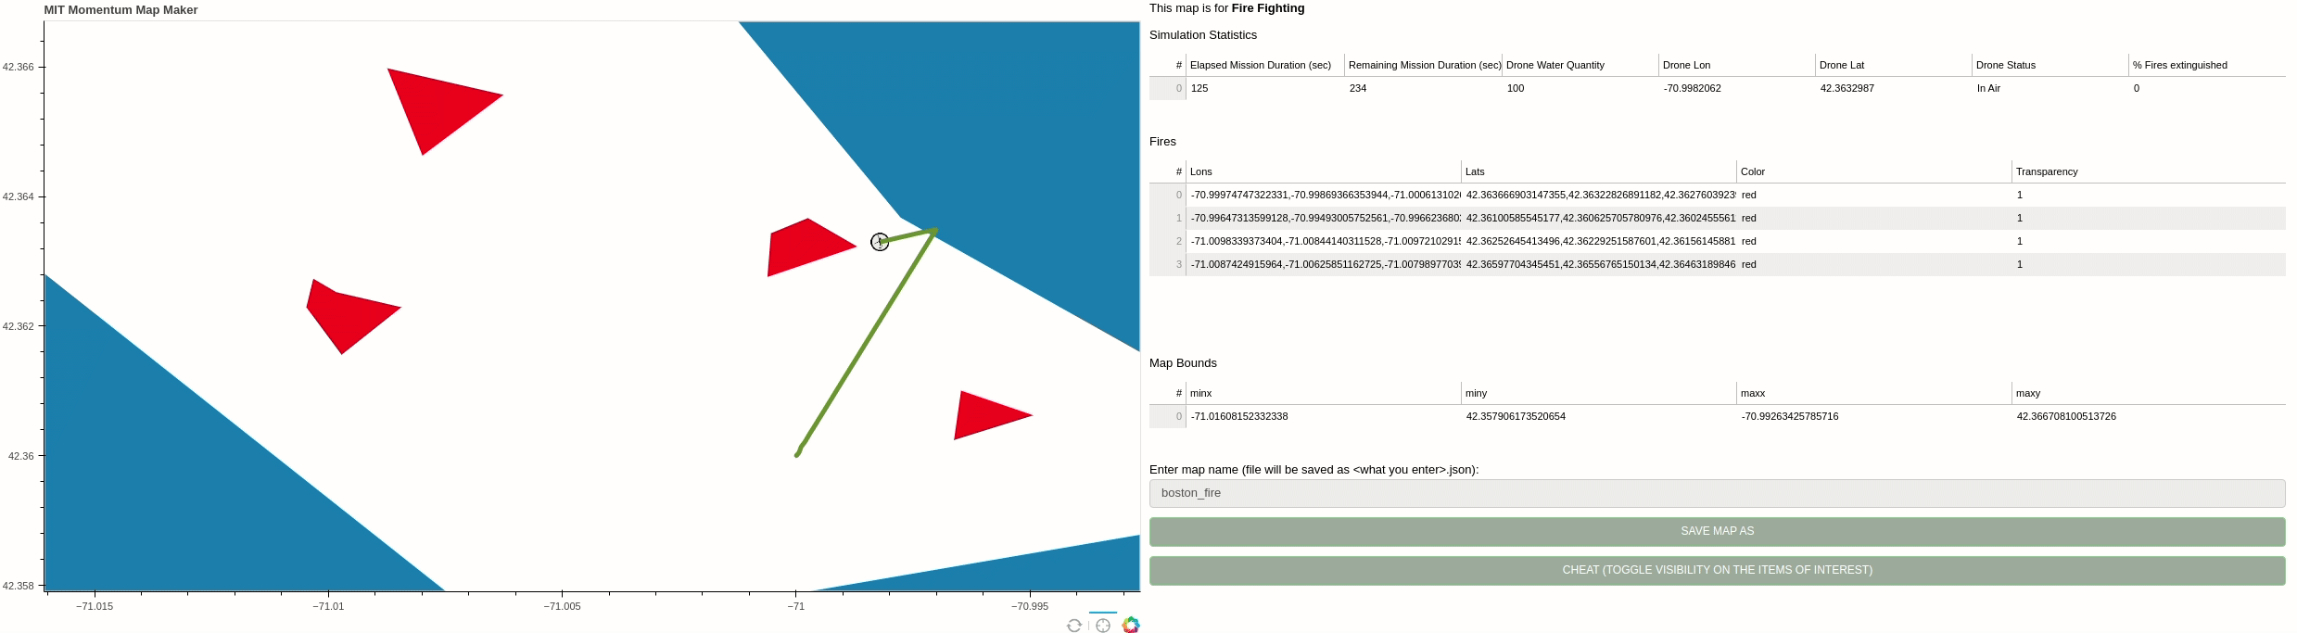
Usage: Visualizer
The drone position is marked with an avatar
Drone track is the olive green line
Mission statistics are on the right

Slide 17
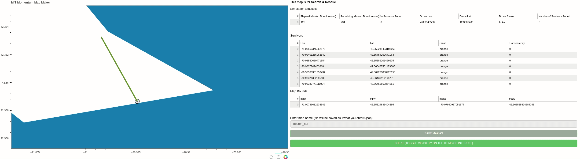
Usage: Visualizer
The drone position is marked with an avatar
Drone track is the olive green line
Mission statistics are on the right

Slide 18
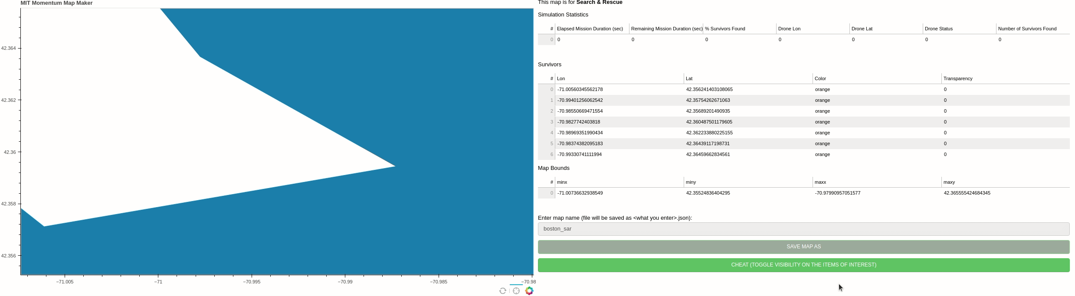

Usage: Miscellaneous Features
The Visualizer, when displaying a Search & Rescue map, can display all of the survivors in the map regardless of their discovery status
To do this, click the CHEAT (TOGGLE VISIBILITY ON THE ITEMS OF INTEREST)
This action invalidates the scoring
You can turn the crosshairs off using the crosshair tool

